Slide 1



MIP-DA-O4-SQL
Hotel Reservation Analysis
USING SQL
Harsh Tantak

Slide 2

Overview
MIP-DA-O4-SQL
The hotel industry relies on data to make informed decisions and provide a better guest experience. Utilizing SQL analysis, this project delves into a hotel reservation dataset to extract valuable insights crucial for informed decision-making in the hospitality industry. Through thorough querying and analysis, we uncover guest preferences, booking trends, and key operational factors essential for enhancing guest experiences and optimizing hotel operations.

Slide 3


Dataset Details
MIP-DA-O4-SQL
The dataset includes the following columns:
Booking_ID: A unique identifier for each hotel reservation.
no_of_adults: The number of adults in the reservation.
no_of_children: The number of children in the reservation. no_of_weekend_nights: The number of nights in the reservation that fall on weekends.
no_of_week_nights: The number of nights in the reservation that fall on weekdays.
type_of_meal_plan: The meal plan chosen by the guests. room_type_reserved: The type of room reserved by the guests. lead_time: The number of days between booking and arrival. arrival_date: The date of arrival.
market_segment_type: The market segment to which the reservation belongs.
avg_price_per_room: The average price per room in the reservation.
booking_status: The status of the booking.

Slide 4


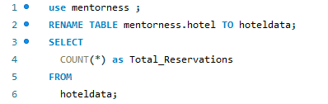
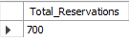
MIP-DA-O4-SQL
1. What is the total number of reservations in the dataset?

Slide 5
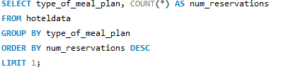
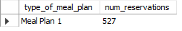
MIP-DA-O4-SQL
2. Which meal plan is the most popular among guests?

Slide 6
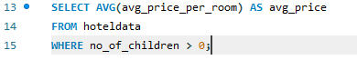
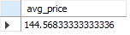
MIP-DA-O4-SQL
3. What is the average price per room for reservations involving children?

Slide 7
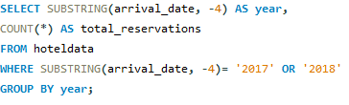
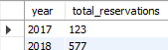
MIP-DA-O4-SQL
4. How many reservations were made for the year 20XX (replace XX with the desired year)?

Slide 8
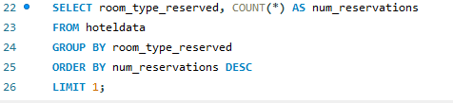
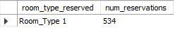
MIP-DA-O4-SQL
5. What is the most commonly booked room type?

Slide 9
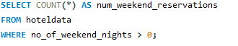
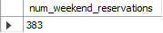
MIP-DA-O4-SQL
6. How many reservations fall on a weekend (no_of_weekend_nights > 0)?

Slide 10
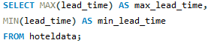
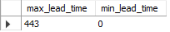
MIP-DA-O4-SQL
7. What is the highest and lowest lead time for reservations?

Slide 11
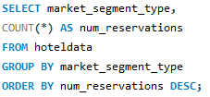
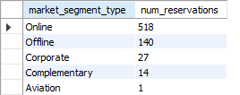
MIP-DA-O4-SQL
8. What is the most common market segment type for reservations?

Slide 12
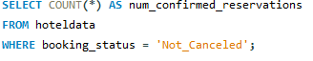
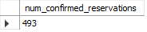
MIP-DA-O4-SQL
9. How many reservations have a booking status of "Confirmed"?

Slide 13
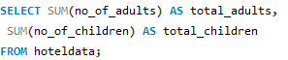
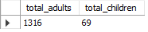
MIP-DA-O4-SQL
10. What is the total number of adults and children across all reservations?

Slide 14
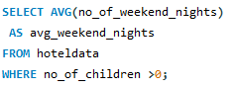
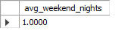
MIP-DA-O4-SQL
11. What is the average number of weekend nights for reservations involving children?

Slide 15
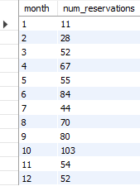
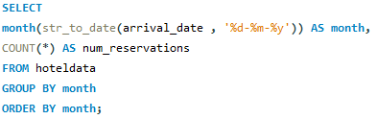
MIP-DA-O4-SQL
12. How many reservations were made in each month of the year?

Slide 16
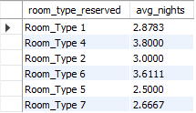
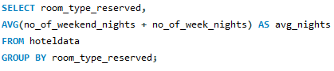
13. What is the average number of nights (both weekend and weekday) spent by guests for each room type?
MIP-DA-O4-SQL

Slide 17
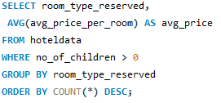
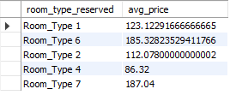
14. For reservations involving children, what is the most common room type, and what is the average price for that room type?
MIP-DA-O4-SQL

Slide 18
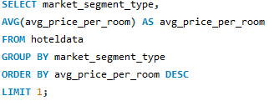
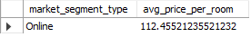
MIP-DA-O4-SQL
15. Find the market segment type that generates the highest average price per room.

Slide 19

MIP-DA-O4-SQL
Thank you!
Thank you all for going through this project.

